Slide 1
Predicting the House Price of Unit Area
Real estate valuation data set
Luther Nicholaus
CIS 607

Slide 2

Problem Statement.
Establish, test, and score a model for predicting the house price based on select independent variables.
Market: Sindian District, New Taipei City, Taiwan.

Slide 3
Dataset
Title: “Real estate valuation data set”
Source: The UCI Machine Learning Repository.
A sample of 414 houses collected for the established market.
Collected between 2012 & 2013.
Details houses’ transactional dates, age, location, price, distance to the nearest MRT station, and number of convenience store

Slide 4
Research Questions & Hypotheses
Research | Question/Hypothesis | Method Used
Primary Research | What is the prediction model of house prices in Taipei City? | Regression
Research Hypothesis 2 | Is there enough evidence to fail to reject Chen’s (2015) claim that the average house price of unit area is $20,667? | T-test
Research Question 3 | Which houses are fairly-priced and overpriced? | Decision Tree Classification

Slide 5
Data Cleaning and Analysis
Software Used: Python
New column that holds location groups is created by clustering the longitude and latitude variables.
The outcome are two location clusters.
Drop all rows with missing values.
Drop the longitude and latitude columns.

Slide 6
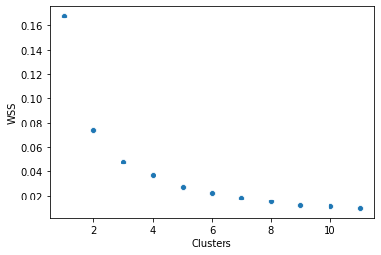
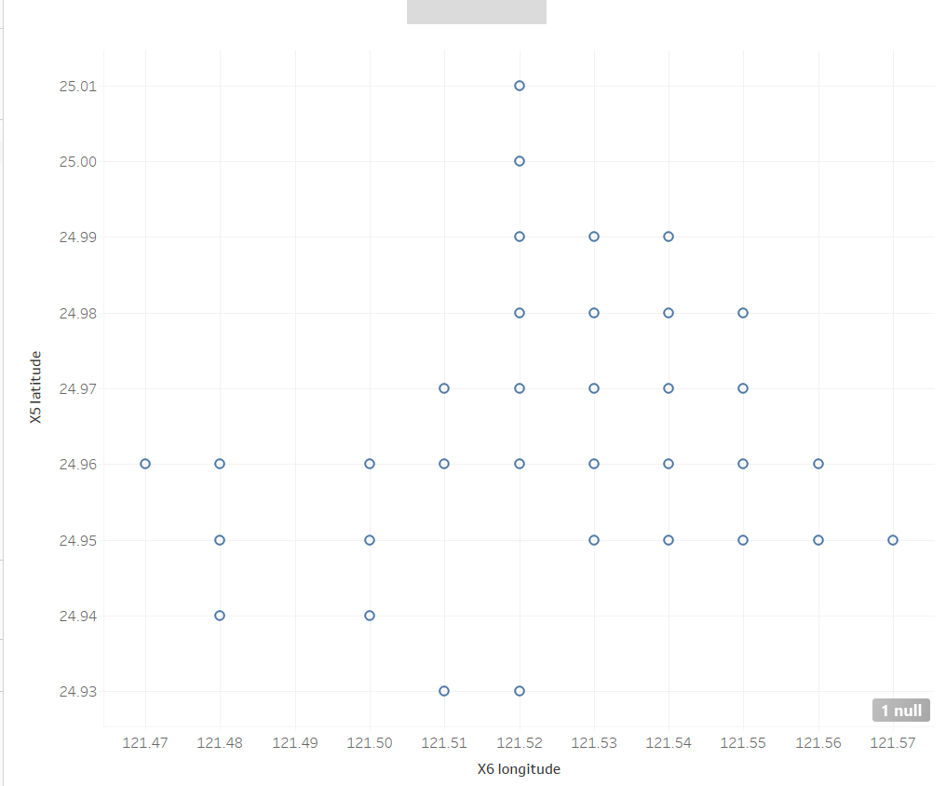
Elbow Method
Latitude and Longitude Plot

Slide 7
Primary Research
Independent Variable | Dependent Variables | Data Training and Testing Method
House Price | House age, distance to the nearest MRT, number of convenience store, & location clusters | Train_Test_Spilt Function 80% Train to 20% Test
Results:
51% coefficient of determination.
Model training score of 71.53%.

Slide 8
Research Hypothesis 2
Null Hypothesis | Alternative Hypothesis | Test
Average Price = 20,667 | Average Price <> 20,667 | T-Test (two-sided) Significance level is 5%
Results:
P-value is significantly less than the level of significance of 0.05
pvalue=1.645179367270192e-88

Slide 9
Research Question 3
A new column (‘Fair”) is extracted: determines if a house is fairly priced. 1 - Fairly-Priced & 0 - Overpriced
Applied the regression model to ascertain home values.
The values are then compared to respective prices.
X values | Y values | Train & Test Method | Model Score
Fair | House age, distance to the nearest MRT, number of convenience store, & location clusters | Train_Test_Spilt Function 80% Train to 20% Test | 84.3%

Slide 10
Analysis Conclusions
The prediction model is y = 42.39 - 0.23(M1) - 0.003(M2) + 1.33(M3) -5.93(M4)
There is sufficient evidence to reject the claim that the average house price of unit area is $20,667.
The decision tree classifier appears to be a solid predictor of if a house is fairly-priced or not

Slide 11

Application
Aid the prediction of house prices in the given market.
Back investment and purchasing decisions using the classifier.

Slide 12

Project Reflection
Learned the application and practicality of different analytical and statistical methodologies.
Challenge / Learning Experience: Independently exploring different analytical tools and modules.

Slide 13
References
Chen, Y.-L. (2016, July 28). The factors and implications of rising housing prices in Taiwan. Brookings. Retrieved September 10, 2021, from https://www.brookings.edu/opinions/the-factors-and-implications-of-rising-housing-prices-in-taiwan/
Yeh, I. C. (2018). Real estate valuation data set Data Set. UCI Machine Learning Repository. Retrieved from https://archive.ics.uci.edu/ml/datasets/Real+estate+valuation+data+set

